Slide 1

AU-NNSA
Enhancing the Bridges to Success in Science, Technology, Engineering and Mathematics Education
Science Education and Research
for Undergraduate and High School Students
Allen University-NNSA Program
November 2010

Slide 2
Goals
AU-NNSA
Position Allen University as a center for excellence in math and science education
Empower college faculty and secondary school teachers with dynamic content for teaching , assessment, and instructional management.

Slide 3
Program Objectives
Build a research base for undergraduate students, preparing them to become members of the workforce addressing areas of national need in science, technology, engineering and mathematics
Implement several community-based initiatives to attract, train and recruit talent from local schools
Provide excellent teaching and research experiences to high school teachers and students and Allen University faculty and students through inter-institutional collaboration

Slide 4
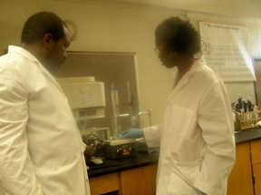
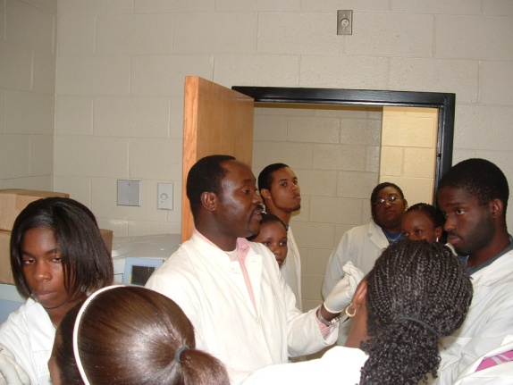
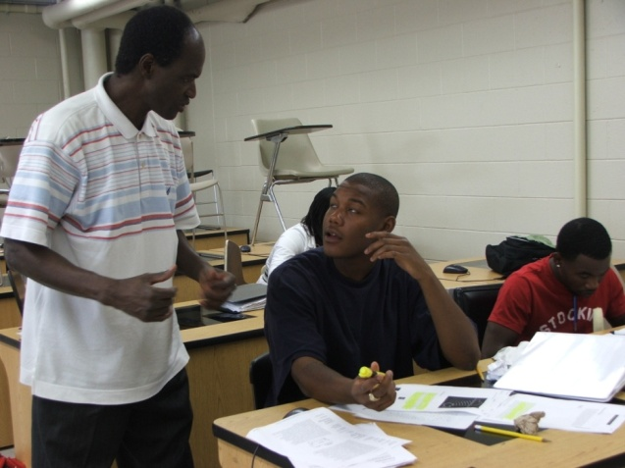
Program Accomplishment 2006-07, 2007-08, 2008-09 Phase I During first three years we focused on undergraduate education and research
AU-NNSA
Revised our curriculum and created all courses on web with dynamic content for all freshman and sophomore level courses in Math and Sciences
Trained teachers for integrating the use of technology in teaching, learning, and assessment and instructional management.
Piloted and implemented Integrated Instructional Delivery System
Improved retention resulting in 65% increase in student population and 446% increase in STEM enrollment at Allen University
Dr. Kenneth Alston: Chemistry
Dr. Oluwole Ariyo (center) biologist
Dr. Aliou Gadjiko, Physics

Slide 5
Program Accomplishment 2006-07, 2007-08, 2008-09 Phase 2
AU-NNSA
During last two years, we shifted our focus to secondary education and followed similar approaches.
Continue our collaboration with e-learning company Educosoft and created e-content for secondary schools Math and Science courses aligned with state standards
Provided extensive professional training to teachers to empower them with content knowledge and use of technology tools.
Supported their students through several outreach initiative : SSA, summer refresher courses, science talent contents and online access for content and assessment.

Slide 6
AU-NNSA
Allen University Science Education and Research for Undergraduate and High School Students
2009-2010
Enhance content repository
NNSA Scholar program
SSEI for incoming college freshmen
Coordinating with project portal
Evaluation and research
Building the base for STEM program
Allen University
Content enhancement
Creating course and standard Tests
Coordinate Saturday Science
Academy/talent contest
A Mathematics Education Initiative (MEI) involving local public schools
High/Middle school Partners (Pipeline program)
Improve student interest/success in Math & Science
Project portal
Feature Enhancement
Extending the benefit to all School districts in SC
Center for professional development
In service Training for teachers
Short course development
Workshops and conferences

Slide 7
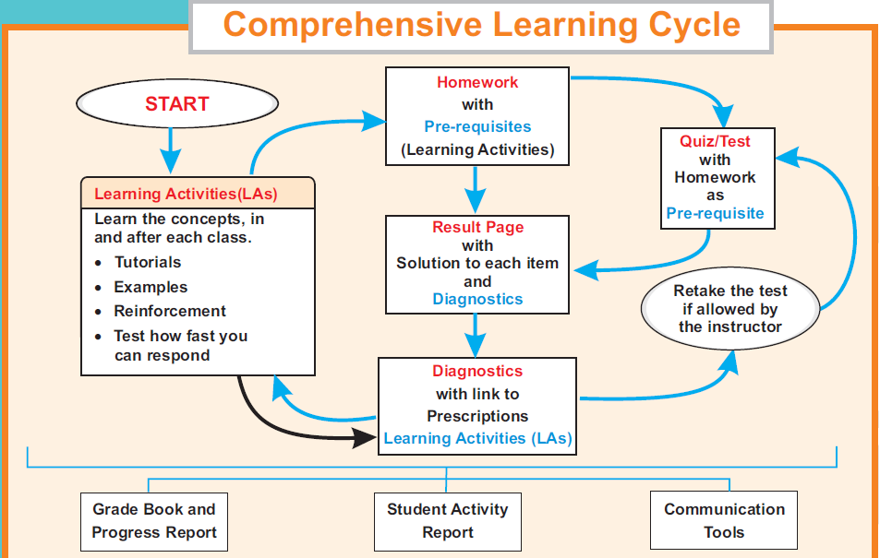
Mode of instruction for teacher training
AU-NNSA
Hybrid course: 2 – 3 hours meeting on every alternate Saturday
Extensive online assignments: Learning through dynamic tutorials, homework with time on learning as prerequisite, quizzes with homework as prerequisite.
During meeting supervised online test, review of new concept, summary of their teaching experience
Same instruction models used for regular student instructions at AU and schools supported by AU-NNSA program.

Slide 8
NNSA Scholars by Classification
AU-NNSA
Classification | 2006-2007 | 2007-2008 | 2008-2009 | 2009-2010
Freshmen | 20 | 20 | 20 | 15
Sophomores | -- | 19 | 18 | 20
Juniors | -- | -- | 17 | 18
Seniors | -- | -- | -- | 17
Totals | 20 | 39 | 55 | 70
2006-2007 cohort Enrollment and Graduation
Enrollment | Graduated | Transfer to other institutions | Expected Graduation in 2011
(2006 – 2007) 20 | 2010 (4 yrs) 11 (55%) | 3 (15%) | 6 (30%)

Slide 9
2009 - 2010 Research participation and Research Presentation by NNSA Students
AU-NNSA
Year | On Campus Research | Off Campus Research | Presentation at Professional/Local Meetings
2009-2010 | 14 | 37 | 27

Slide 10
AU-NNSA
A Mathematics Education Initiative (MEI) involving local public schools
List of Schools, Students, and Teachers who participated in NNSA Project at Allen University so far.
# | Schools receiving support | Number of Teachers trained | Number of Students supported
1 | AC Flora High School | 5 | 261
2 | C A Johnson Preparatory Academy | 10 | 417
3 | Crayon Middle School | 4 | 159
4 | Eau Claire High School | 3 | 395
5 | Great Falls High School | 4 | 183
6 | Richland one Middle School | 4 | 183
7 | Richland one Evening High School | 2 | 167
8 | Ridge View High School | 24 | 709
9 | Spring Valley High School | 14 | 119
10 | W J Keenan High School | 14 | 694
11 | Watkins-Nance Elementary | 4 | 19
 | Total | 83 | 3,294

Slide 11
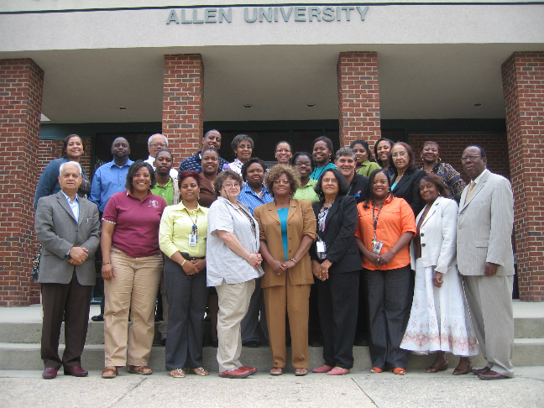
Picture of latest batch of teacher trainers Feb1 to May 15 ,2010
AU-NNSA

Slide 12
Performance report of teachers
AU-NNSA
On the average 29.4 hours spent by each participant on different learning and assessment activities; Approximately 2.1 hrs/ week
Total participants = 83 during 2008- 2010
Grade summary: # of A s = 48, # of B s = 23, # recommended to retake = 12,
and # dropped = 0

Slide 13
AU-NNSA
Teacher feedback on EducoSoft
Feb – May 2010 batch of teachers
Survey Question:
You have been in this course for almost three and a half month now. Do you think this training is helping you to learn the technology? If so, how do you think it will help you as a teacher or to your students when you use it for them.
Typical responses
Yes, it will. I can have more time to help my students... and be effective in the classroom at the same time...more time, more practice and more focus.
It is helping me to understand the system better. As a teacher, I have all the tools at my fingertips and the students have a an on-line tutor to help them with problems that they don't understand.

Slide 14
AU-NNSA
Typical feedback from students at end of the year survey
Survey Question:
Describe briefly about your experiences with EducoSoft.
How did it help you in learning the subject?
Typical responses
It was phenomenal. I really enjoyed educosoft because I learned more in one semester than throughout my high school years. it is impossible to not understand.
Me experiencing this type of system was helpful to my knowledge, it gave me relieve and confidence. Honestly it was the best thing i could have encountered. I hope more systems like this will be entered into all types of forwarding education, and as a learning young adult.

Slide 15
AU-NNSA
Summary of Student and Teacher feedback on Educosoft teaching/Learning portal
Over 90% Students responded positively on their learning experience with Educosoft .
Even better trend was found with teachers. Almost 98% described their experiences with Educosoft as excellent and effective.

Slide 16
Conclusion
AU-NNSA
We have established basic e-learning portal under
collaborative arrangement.
We have a large repository of content for math and
science courses for secondary schools and two year college
level courses.
We have excellent trained cadre of teachers and faculty.
We are now moving in the direction of
a) Extending our course offering to supporting courses like English
compositions, and other courses in general education.
b) Reaching larger audiences in school teachers and colleges through our
key center for excellence at Allen University.

